Slide 1

ECE 220 Computer Systems & Programming
Lecture 20 – Problem Solving with Linked List
Notes:
ECE Main Slide

Slide 2
Review: Linklist and its runtime stack
typedef struct person_node Person;
struct person_node
{
char name[20];
Person *next;
};
int main()
{
Person *theList = NULL;
AddPerson(&theList, “Bob");
AddPerson(&theList, "Bill");
}
/* add to the linked list */
int AddPerson(Person **ourList, char name[])
{
Person *newPerson = NULL;
newPerson = (Person *)malloc(sizeof(Person));
if (newPerson == NULL)
return 0;
strcpy(newPerson->name, name);
newPerson->next = *ourList;
*ourList = newPerson;
return 1;
}
1
2
3
1
2

Slide 3
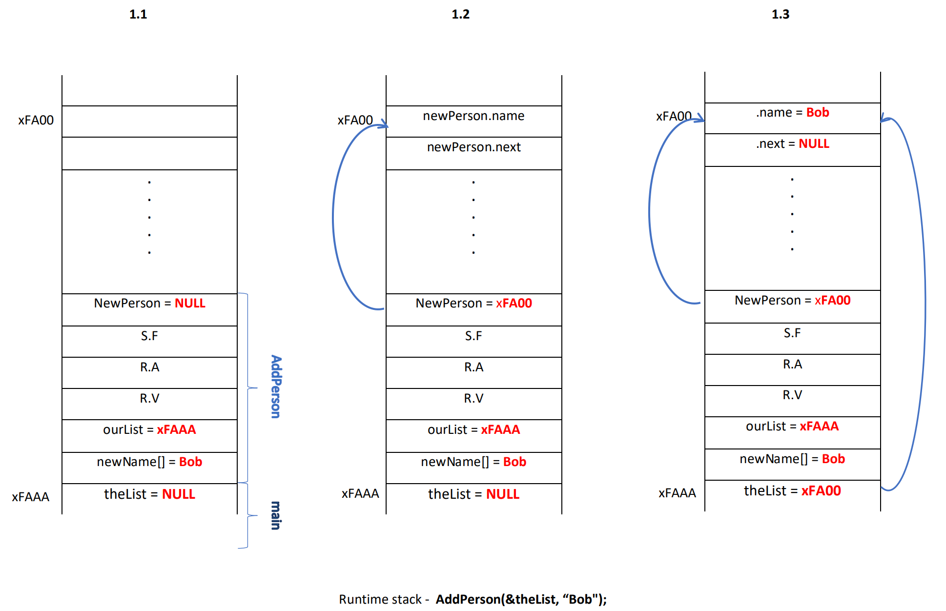

Slide 4
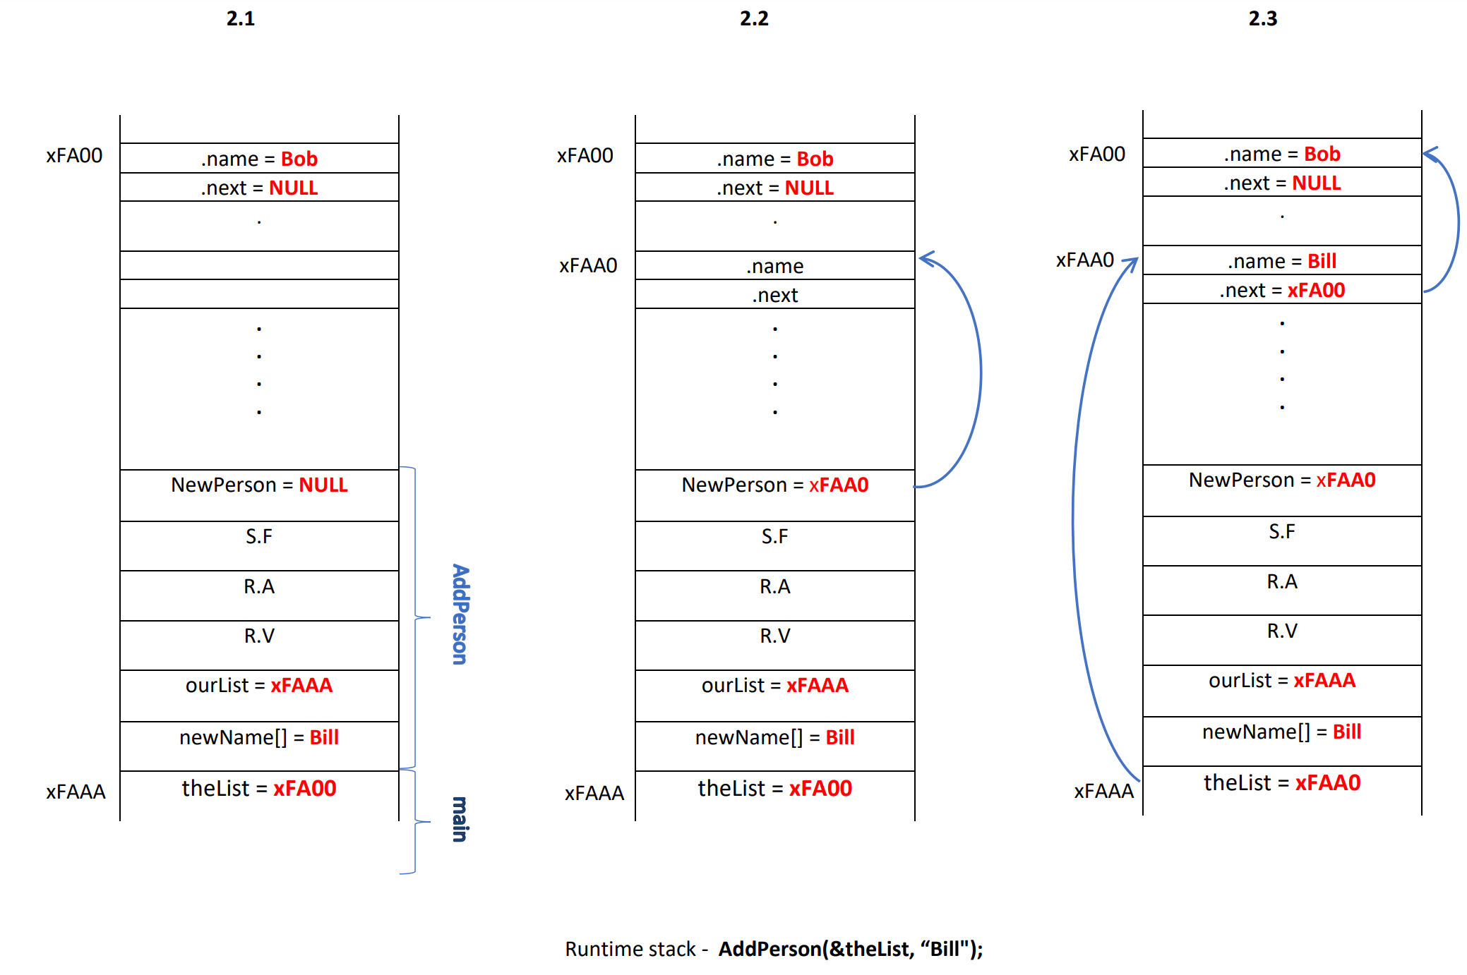

Slide 5
Stack data types
Stack
First item in is the last item out - _______________
Two operations for data movement: ___________ & ___________
Stack can be implemented as a linked list in which
adding and removing elements occurs at the top of the list
(LIFO)
Functions to add and remove elements from a stack:
push and pop
6

Slide 6
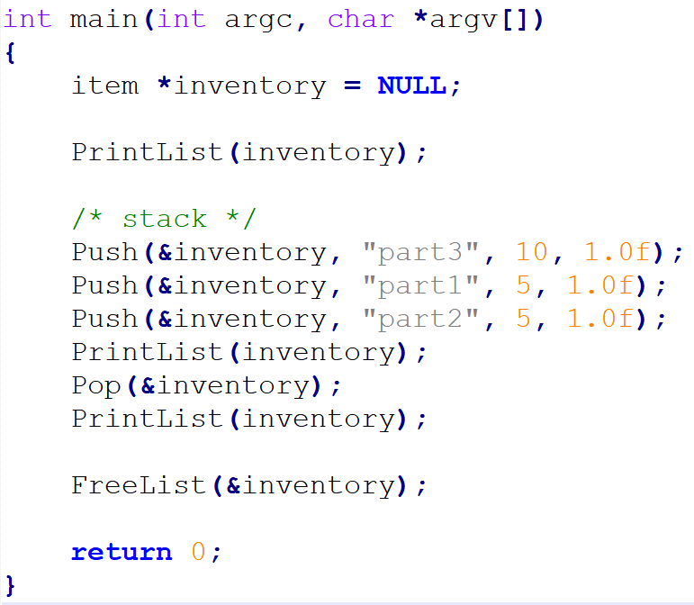
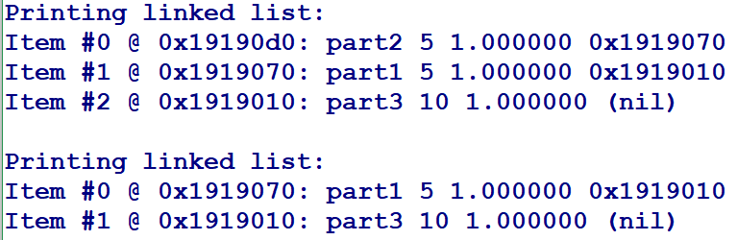
Stack (code)

Slide 7
Queue data types
Queue
First item in is the first item out - _______________
Two operations for data movement: ___________ & ___________
Queue is a linked list in which adding a new element
occurs at the end of the list and removing an
element occurs at the start of the list.
Functions to add and remove elements:
enqueue and dequeue
Front
End
6

Slide 8
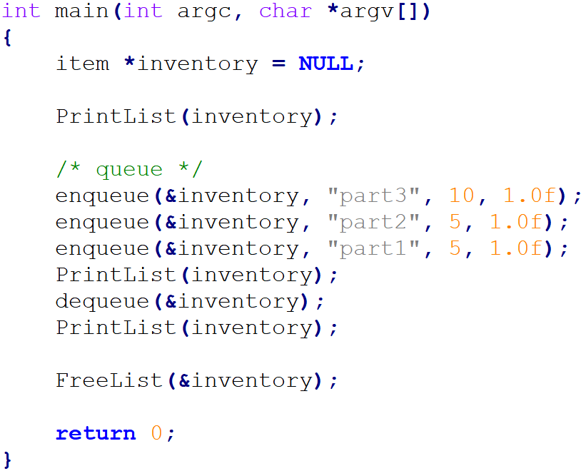
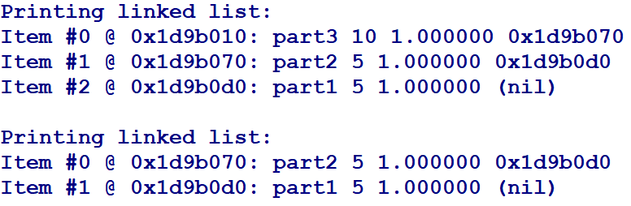
Queue (code)

Slide 9
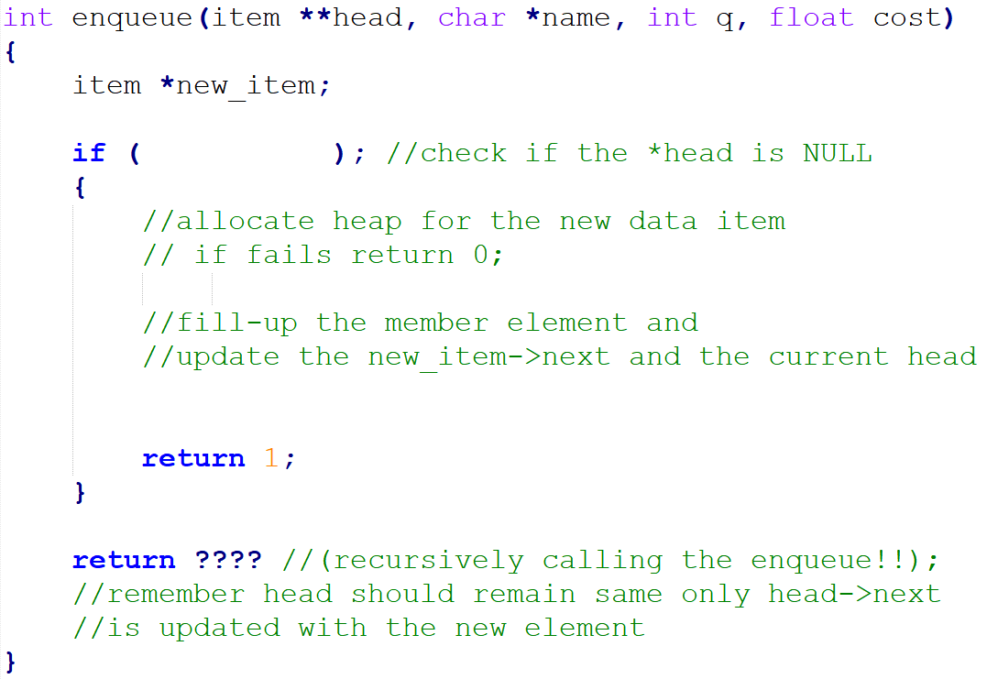
Queue implementation using a linked list
8

Slide 10
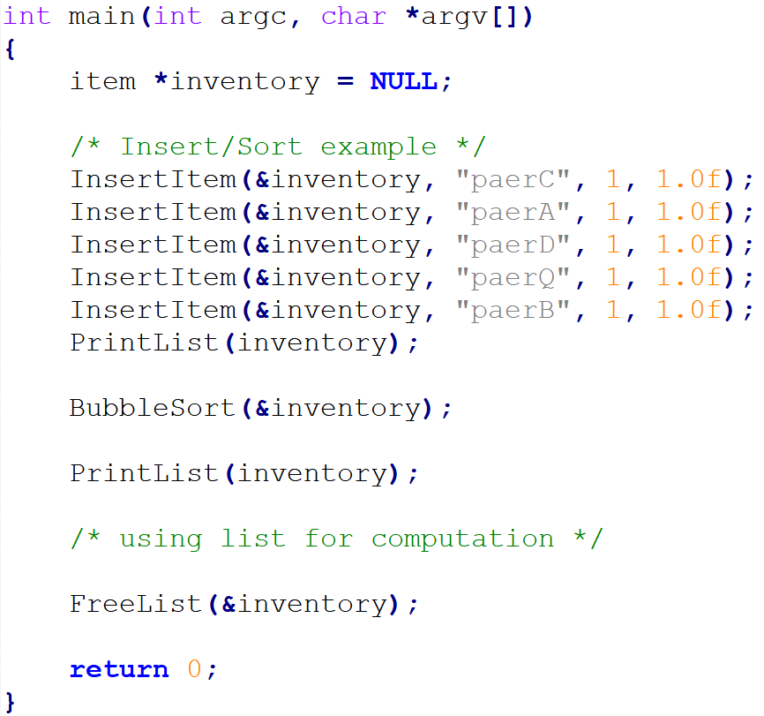
Linklist Sorting Algorithm – Bubble Sort

Slide 11
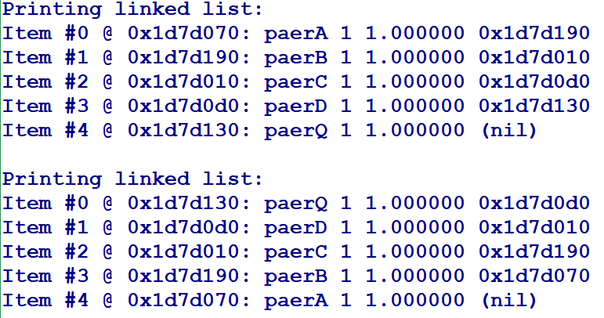
Result from Bubble Sort Algorithm:

Slide 12
Doubly linked list
typedef struct studentStruct Record;
struct studentStruct
{
char Name[100];
int UIN;
float GPA;
Record *prev;
Record *next;
};
Head Pointer
Node 0
Node 1
Node 2
NULL
NULL
5

Slide 13
Implement abstract data types using linked list
Stack
Queue
Deque (“Deck”, double-ended queue)
7

